Slide 1

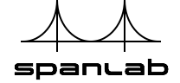
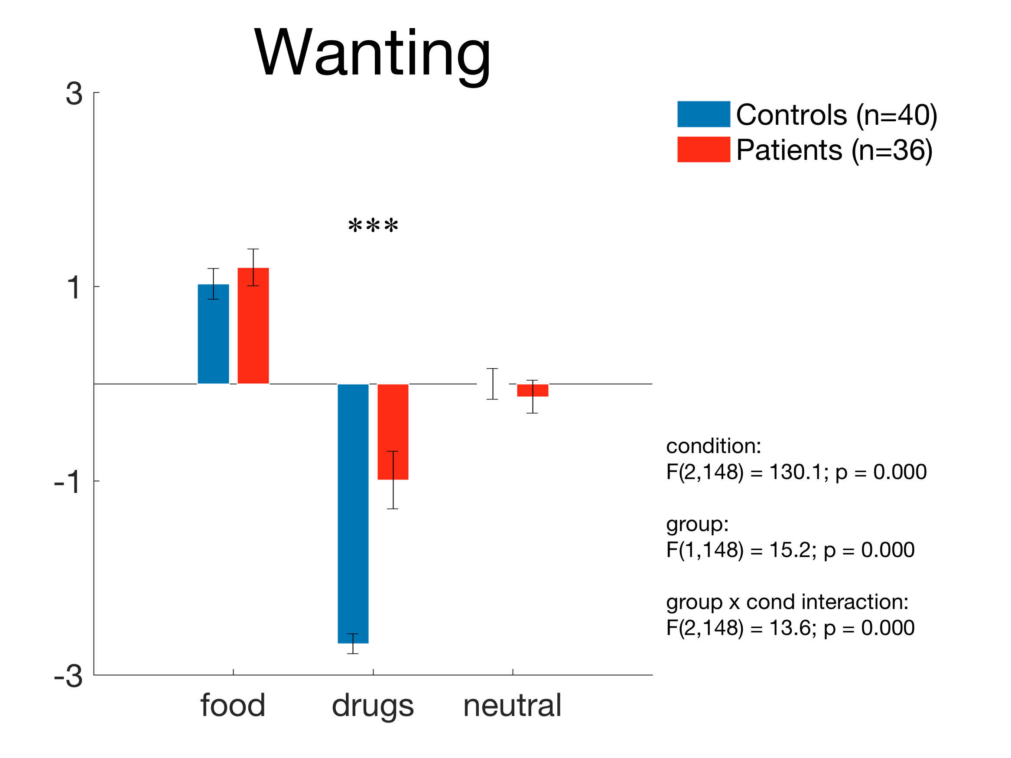
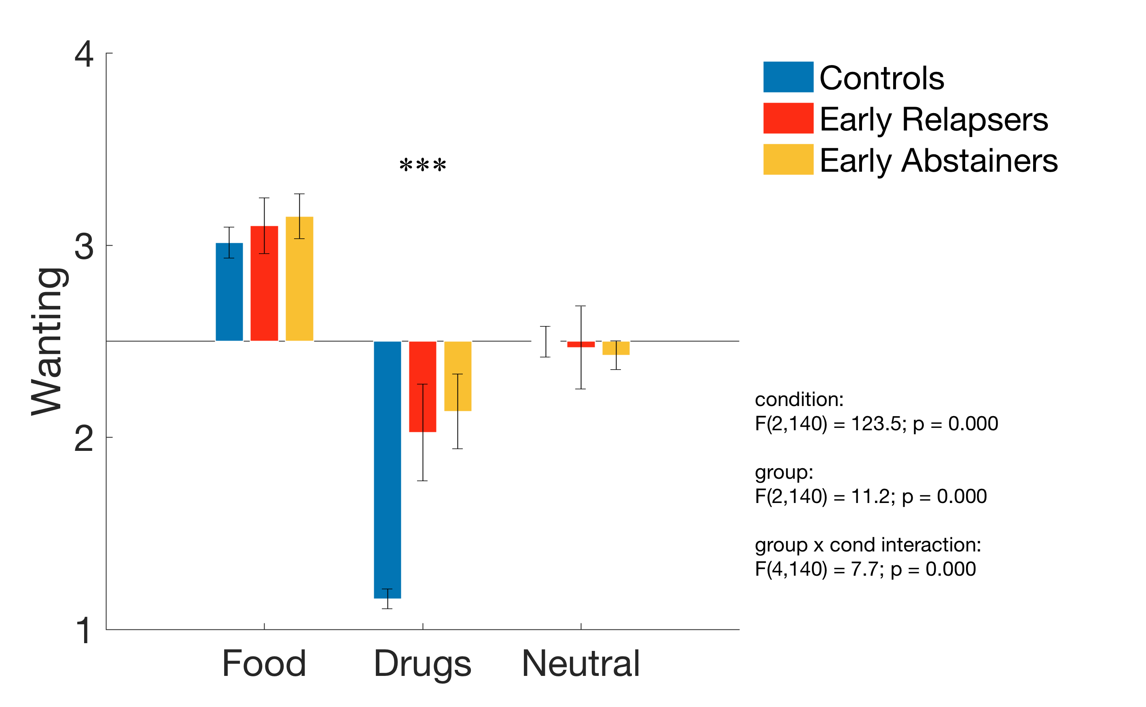
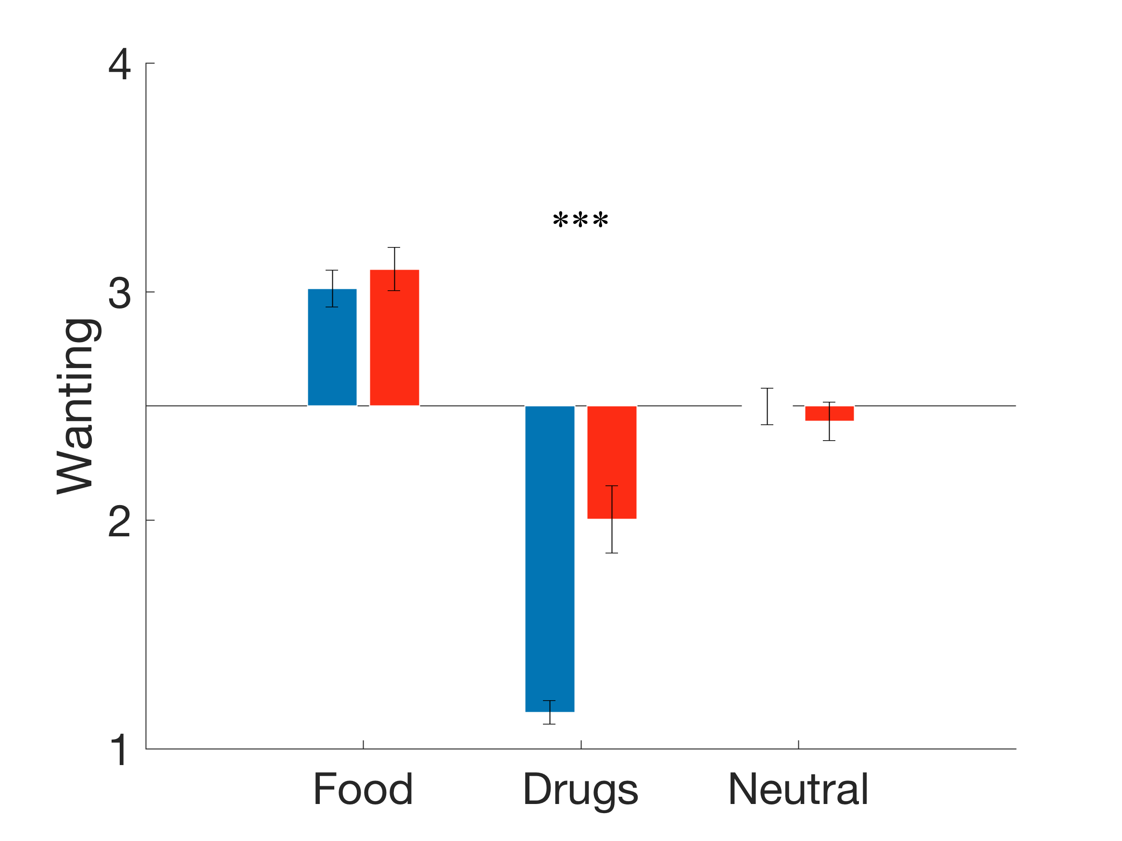
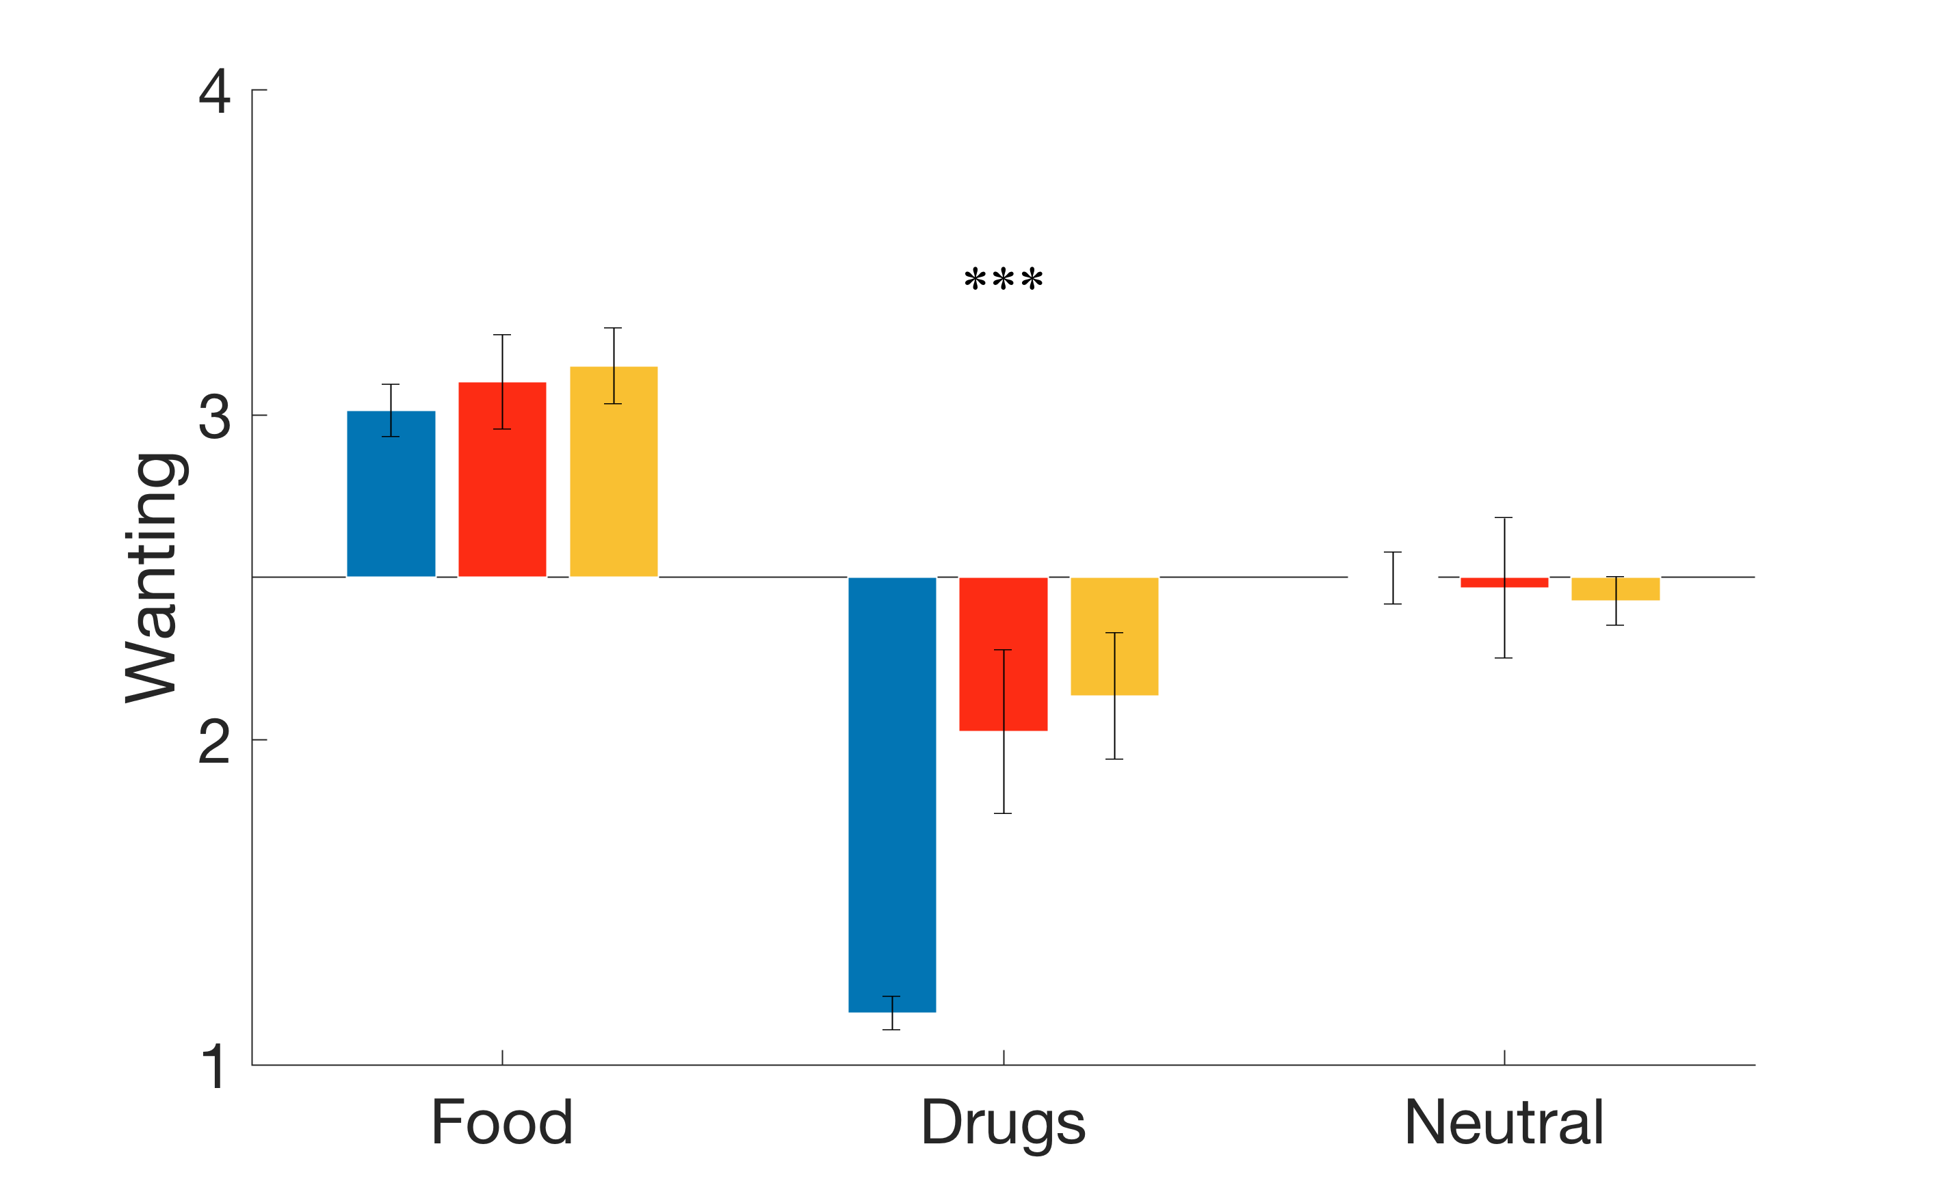
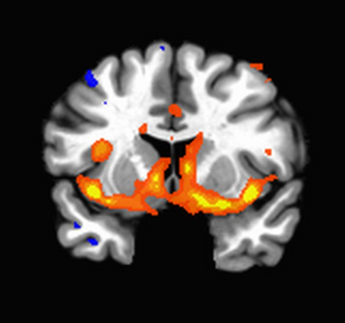
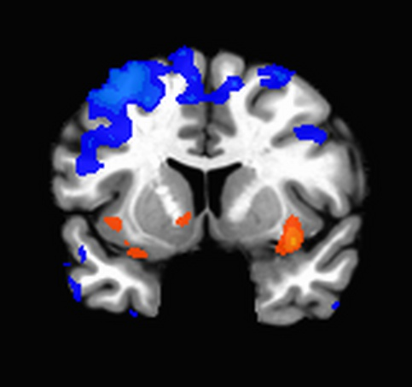
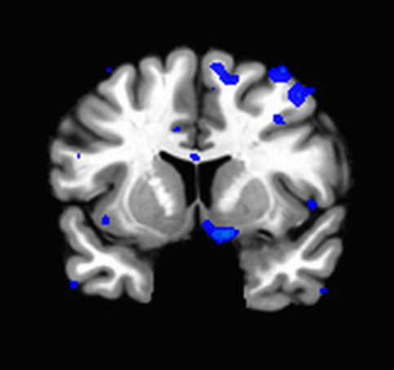

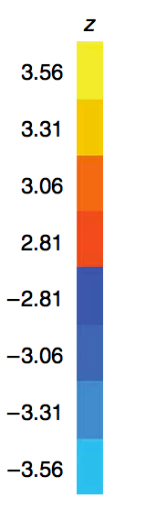
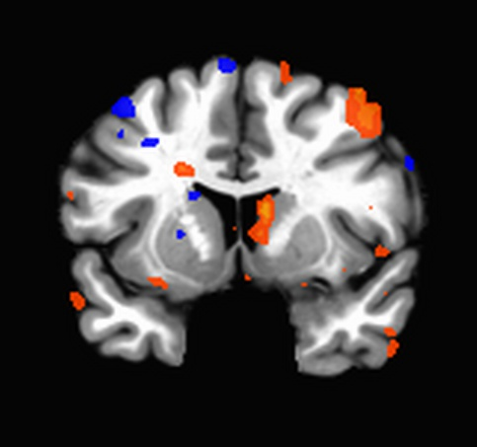
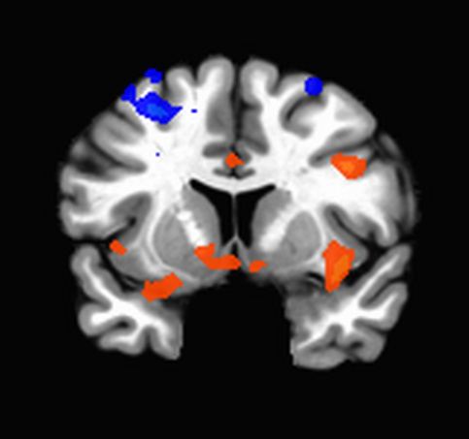
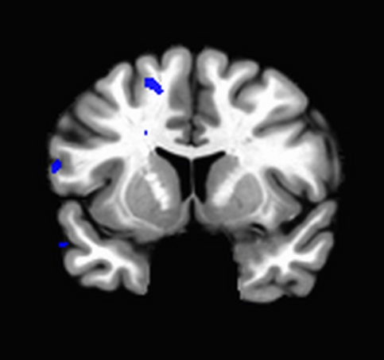
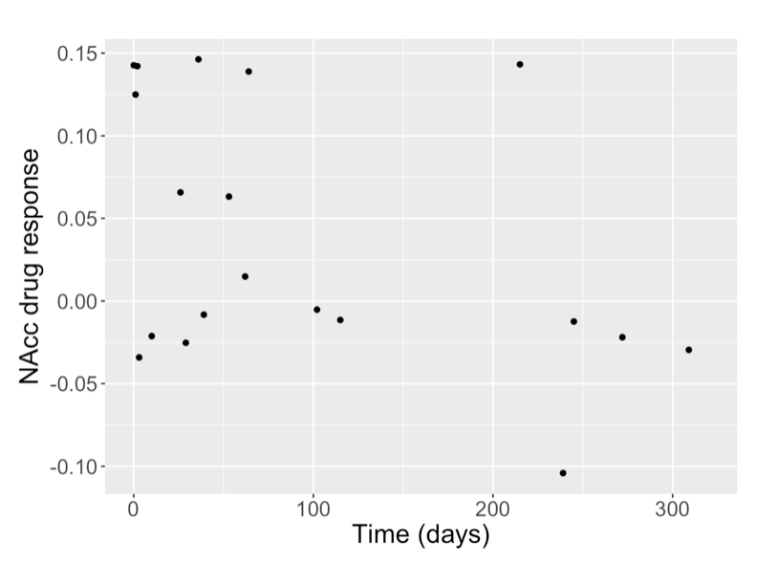
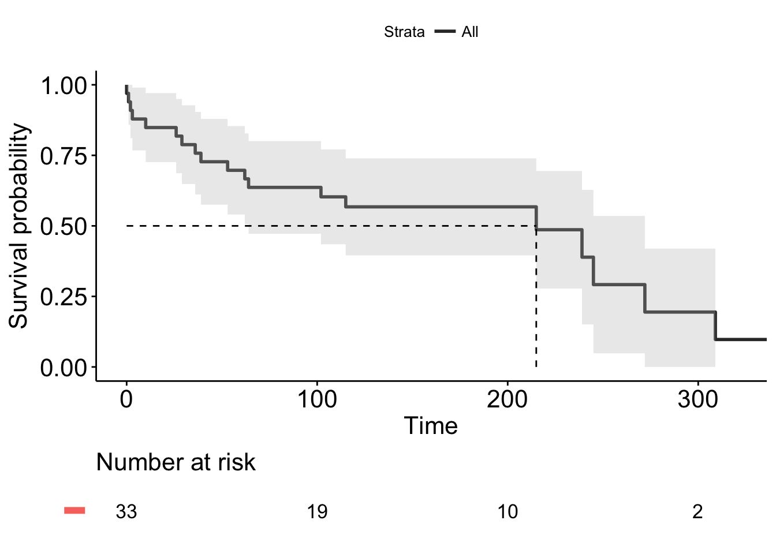
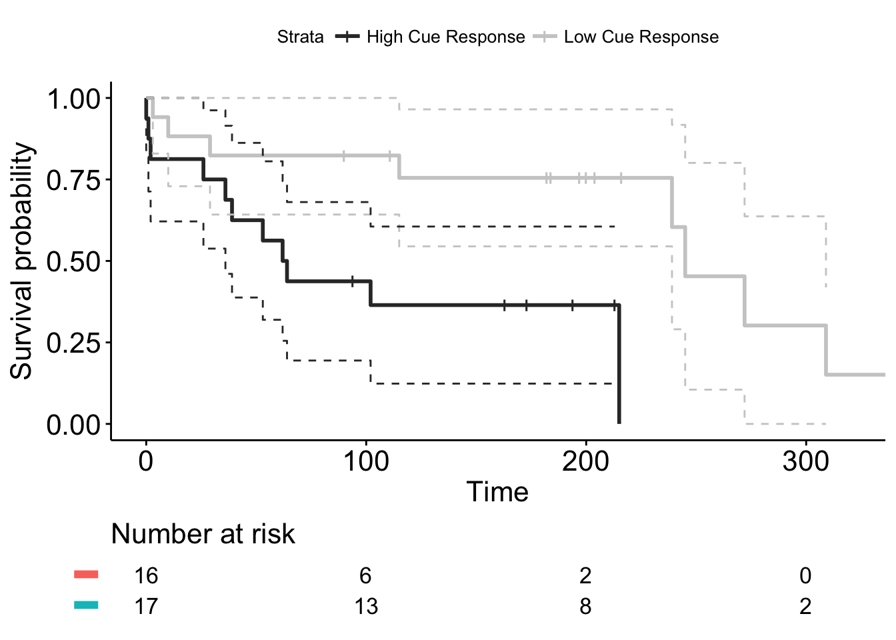
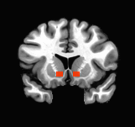
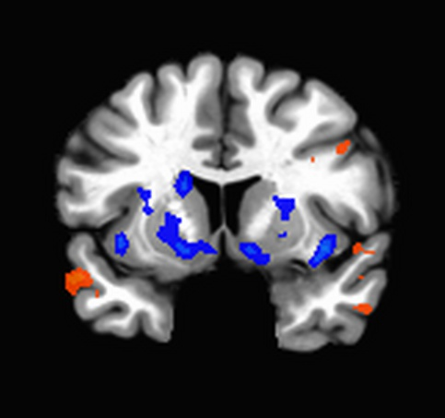
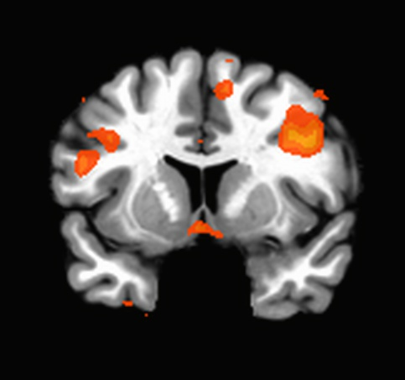
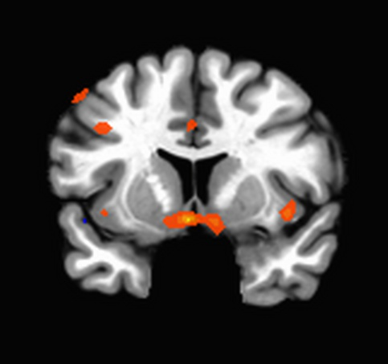

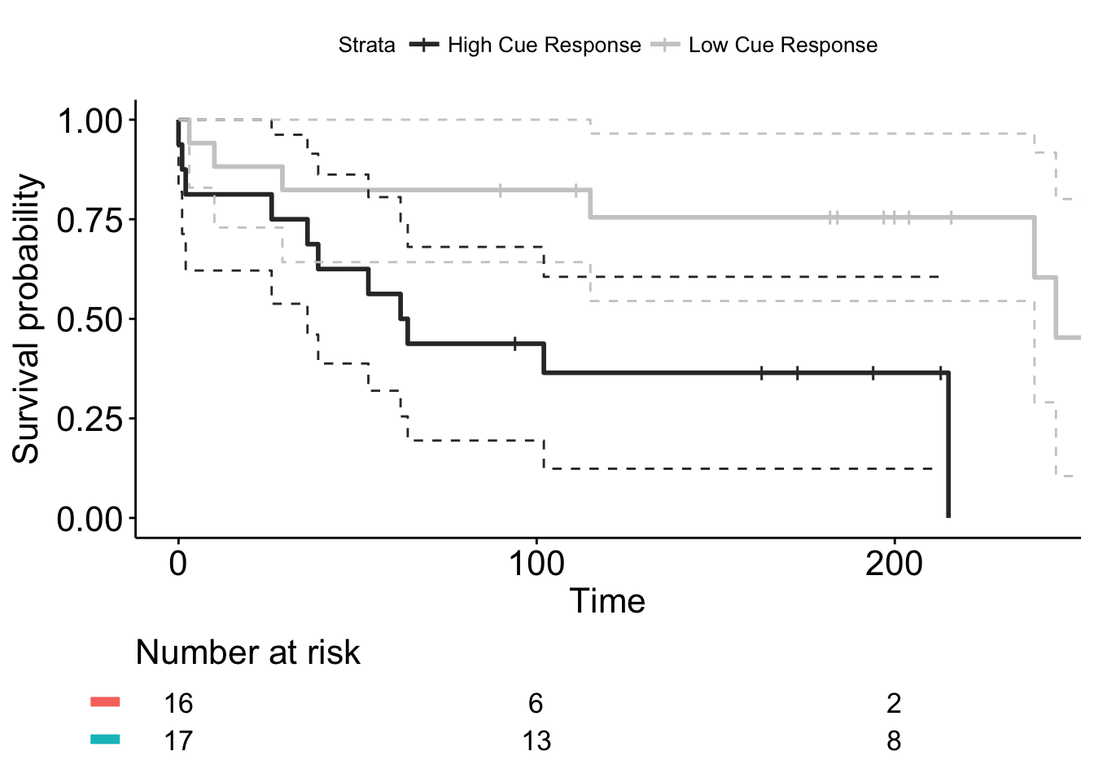
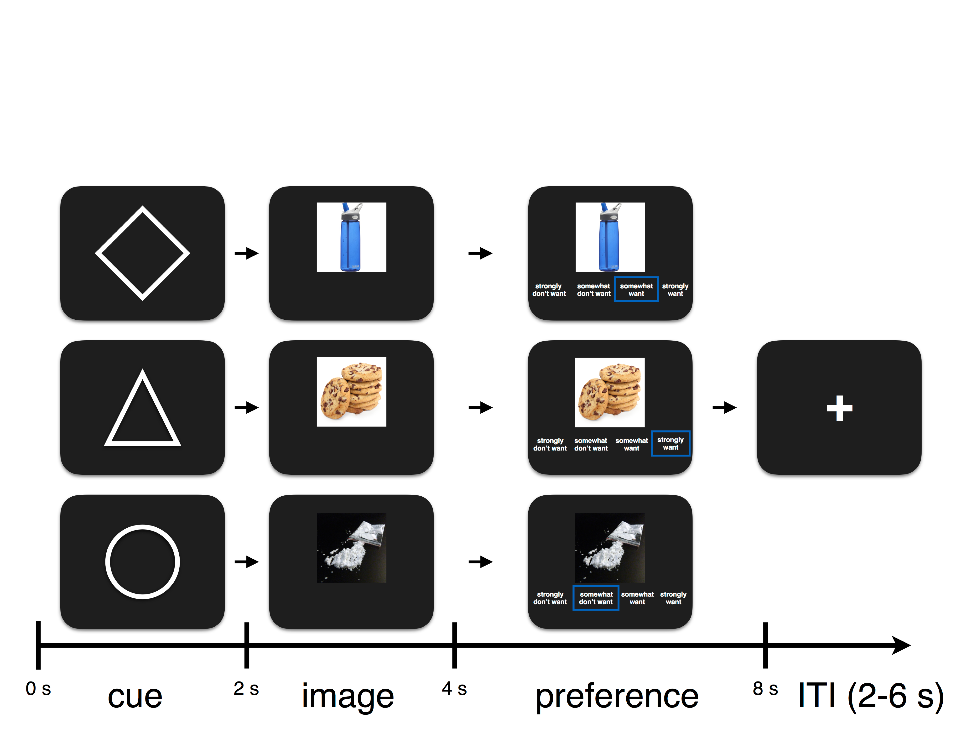
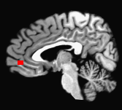
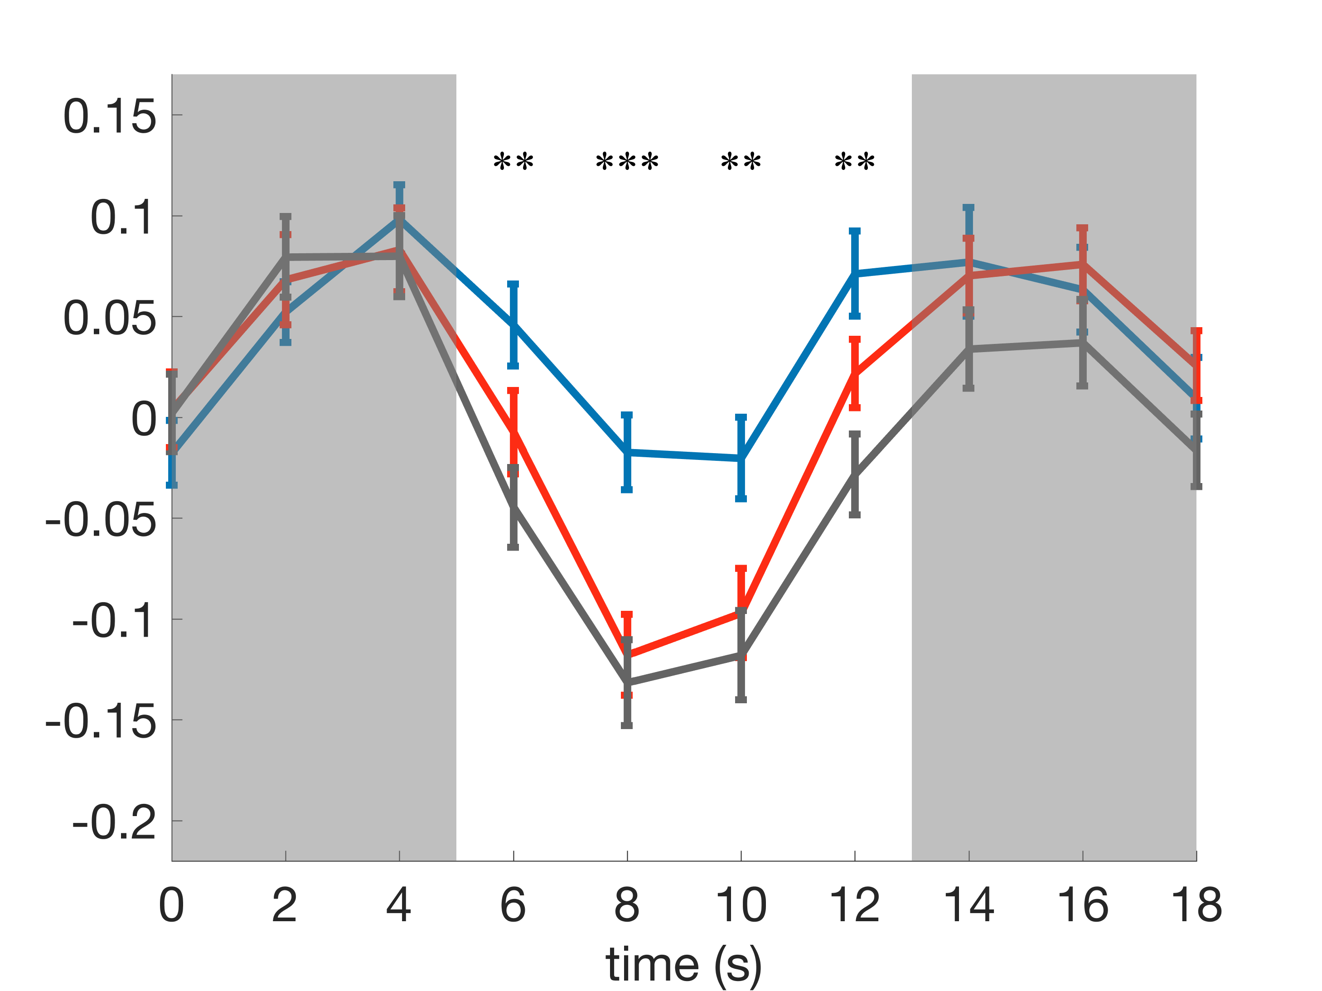
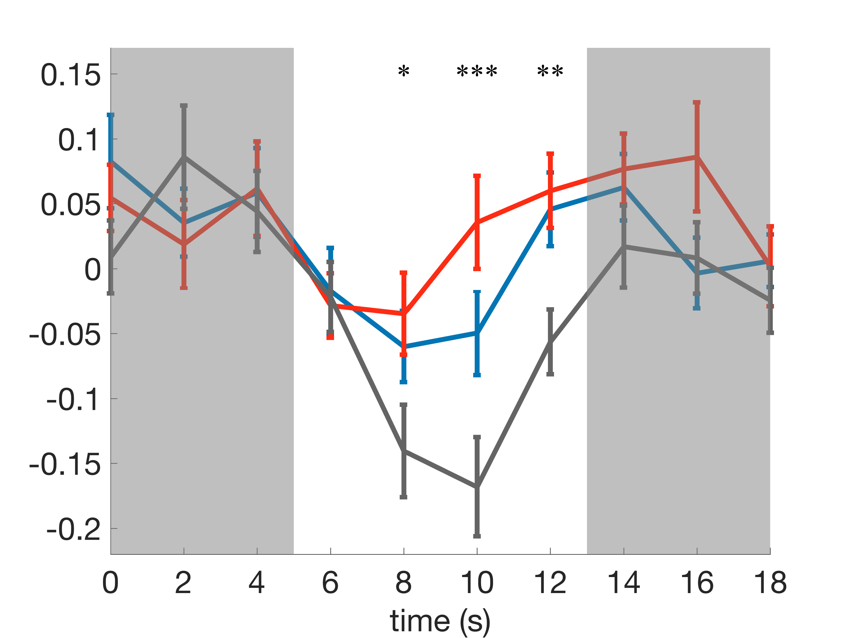
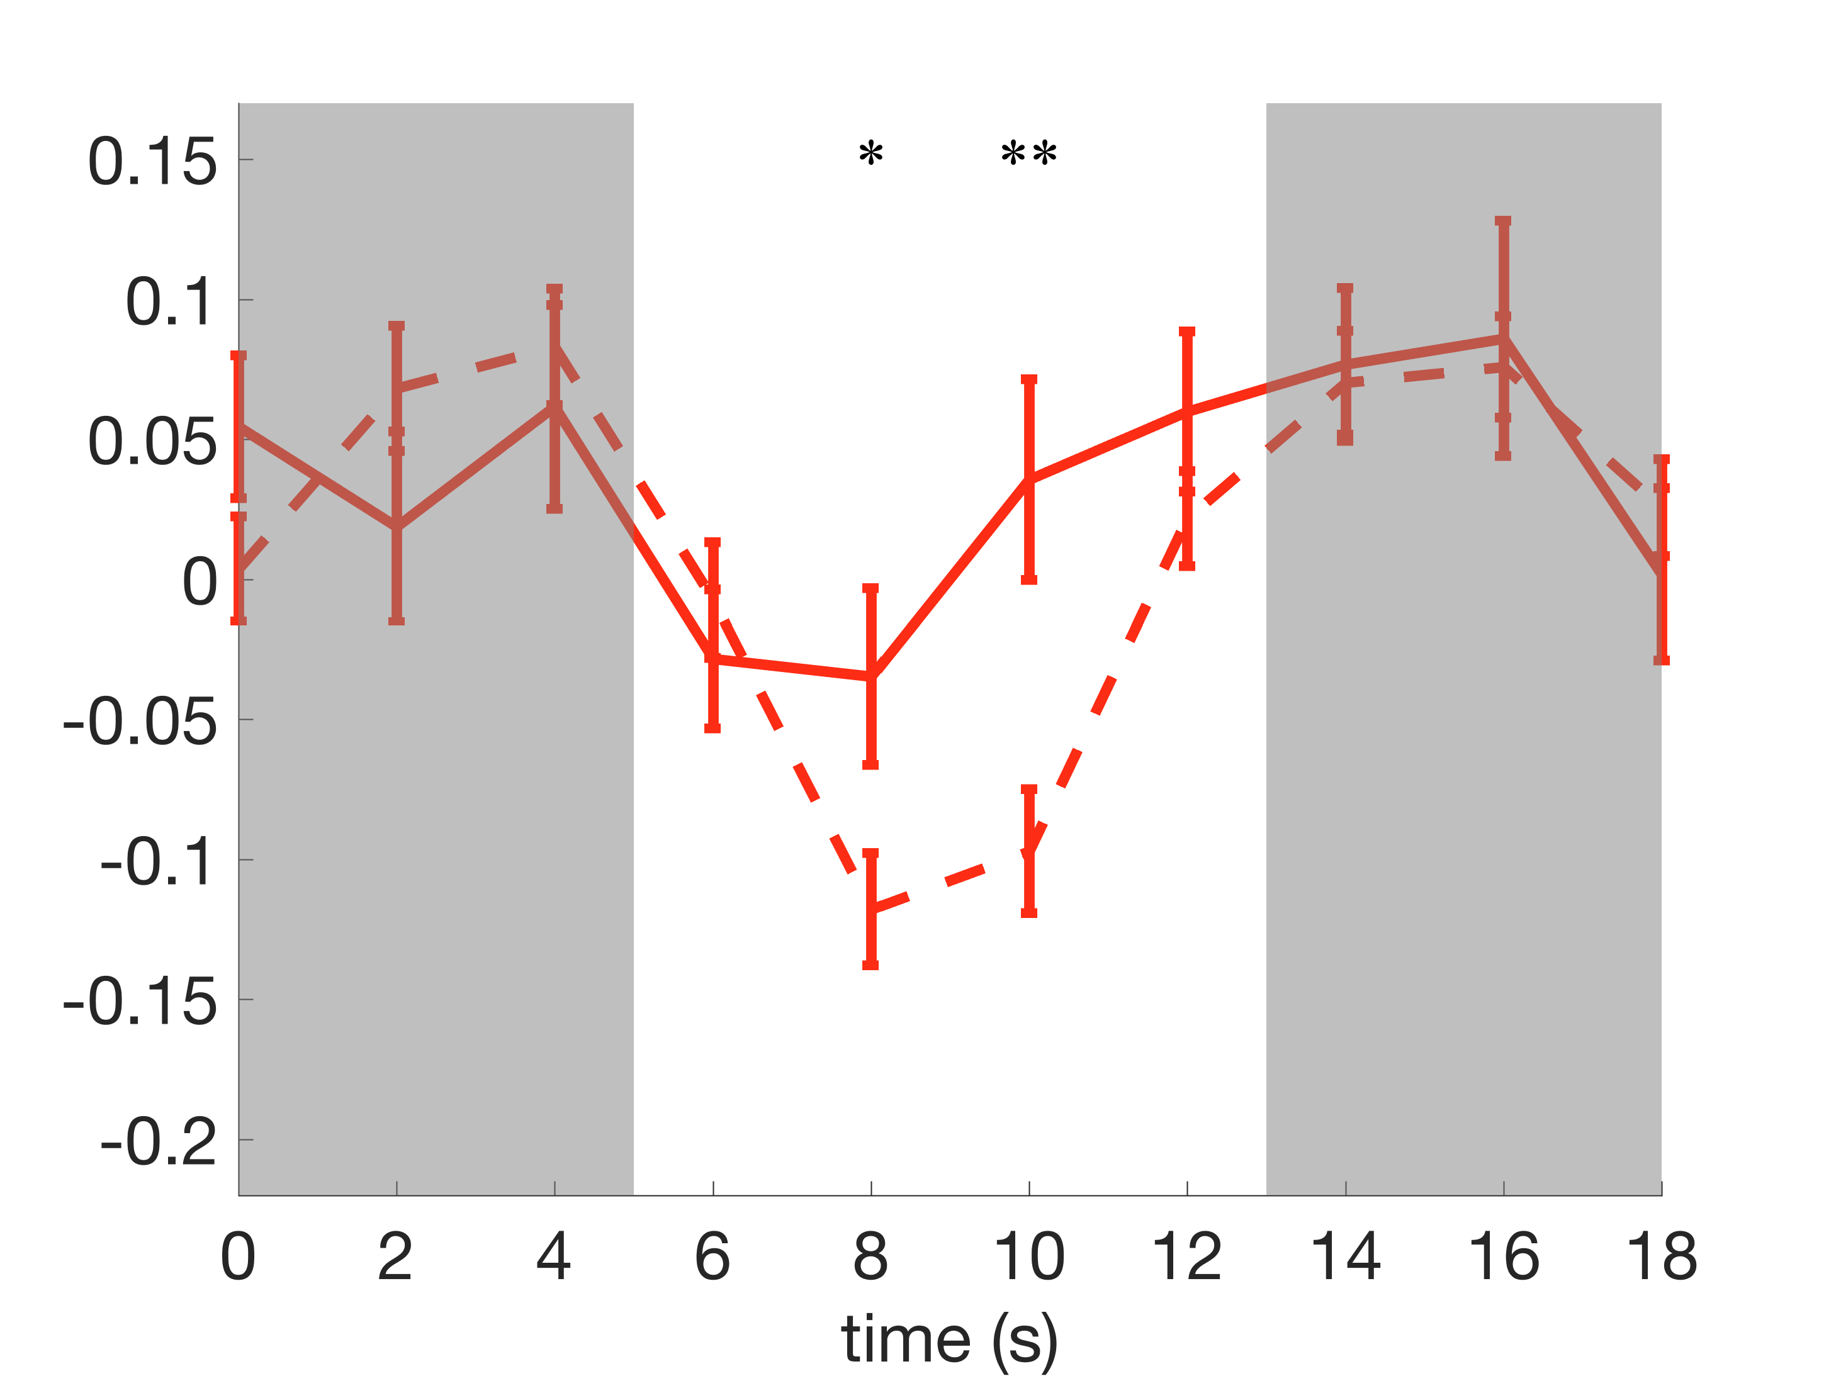
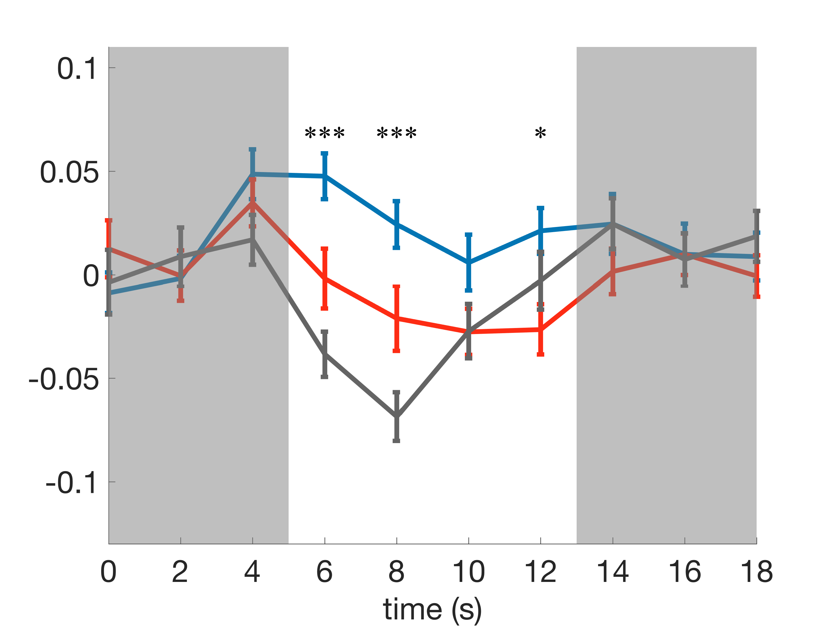
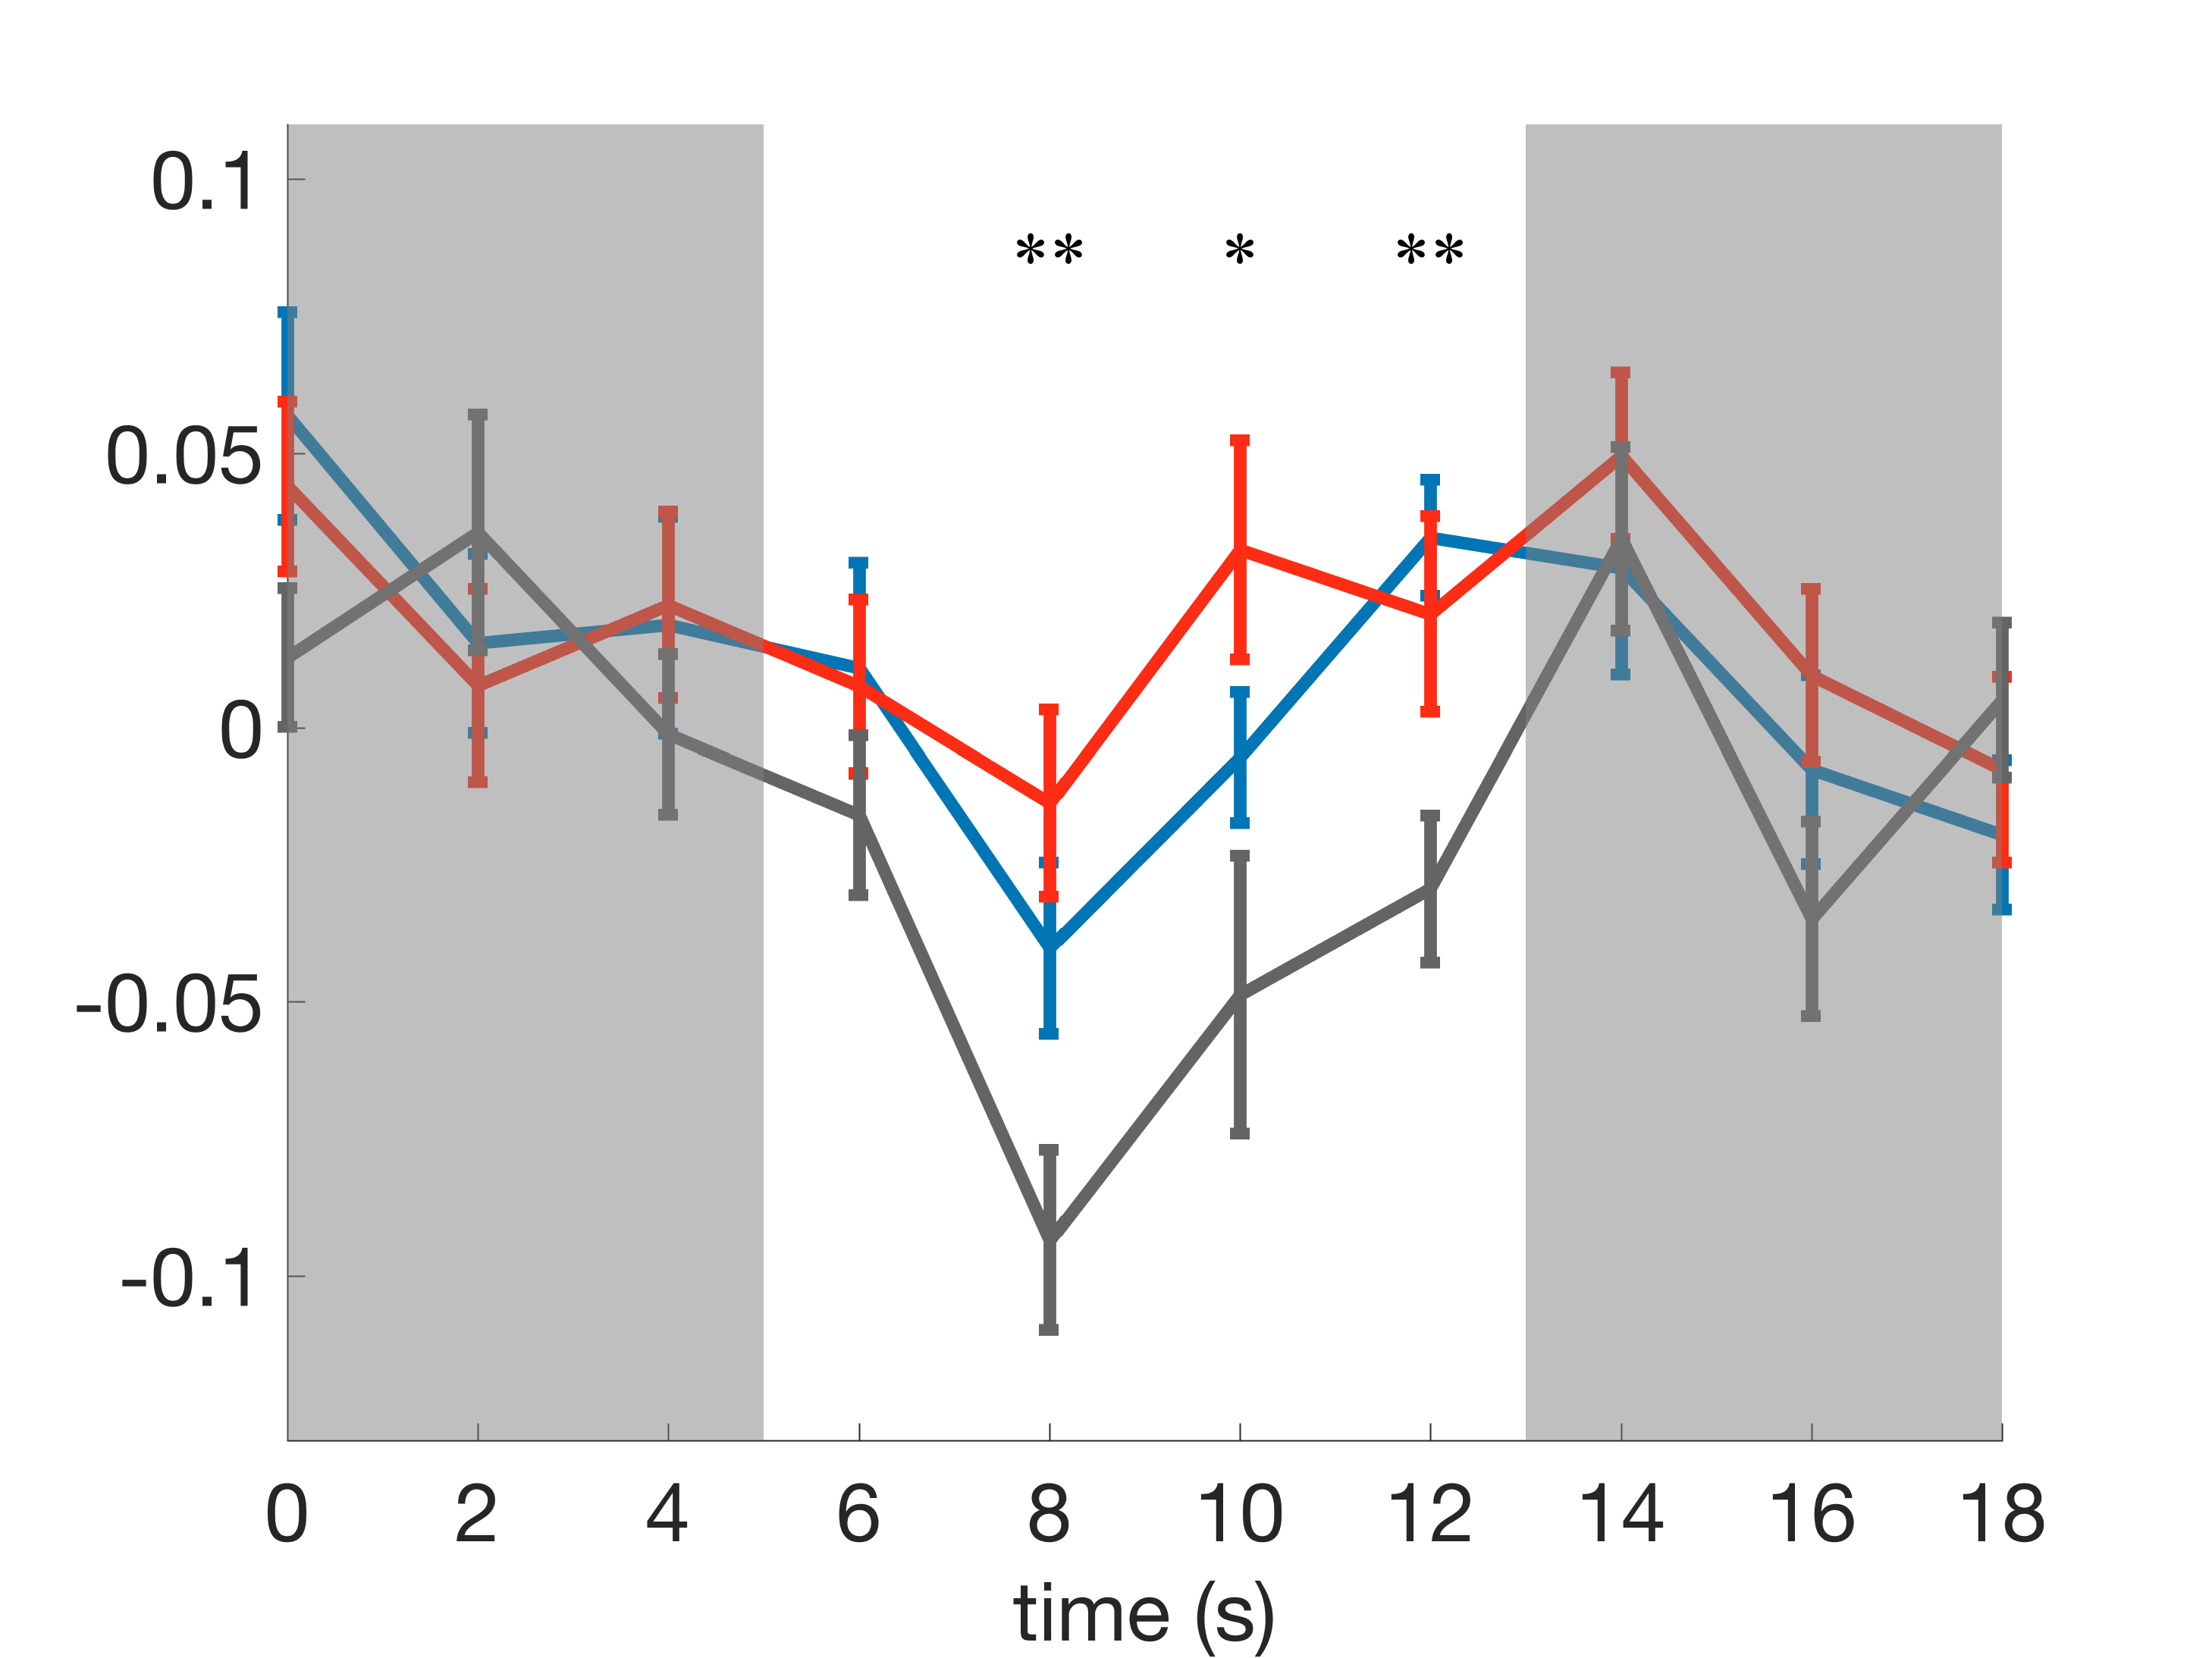
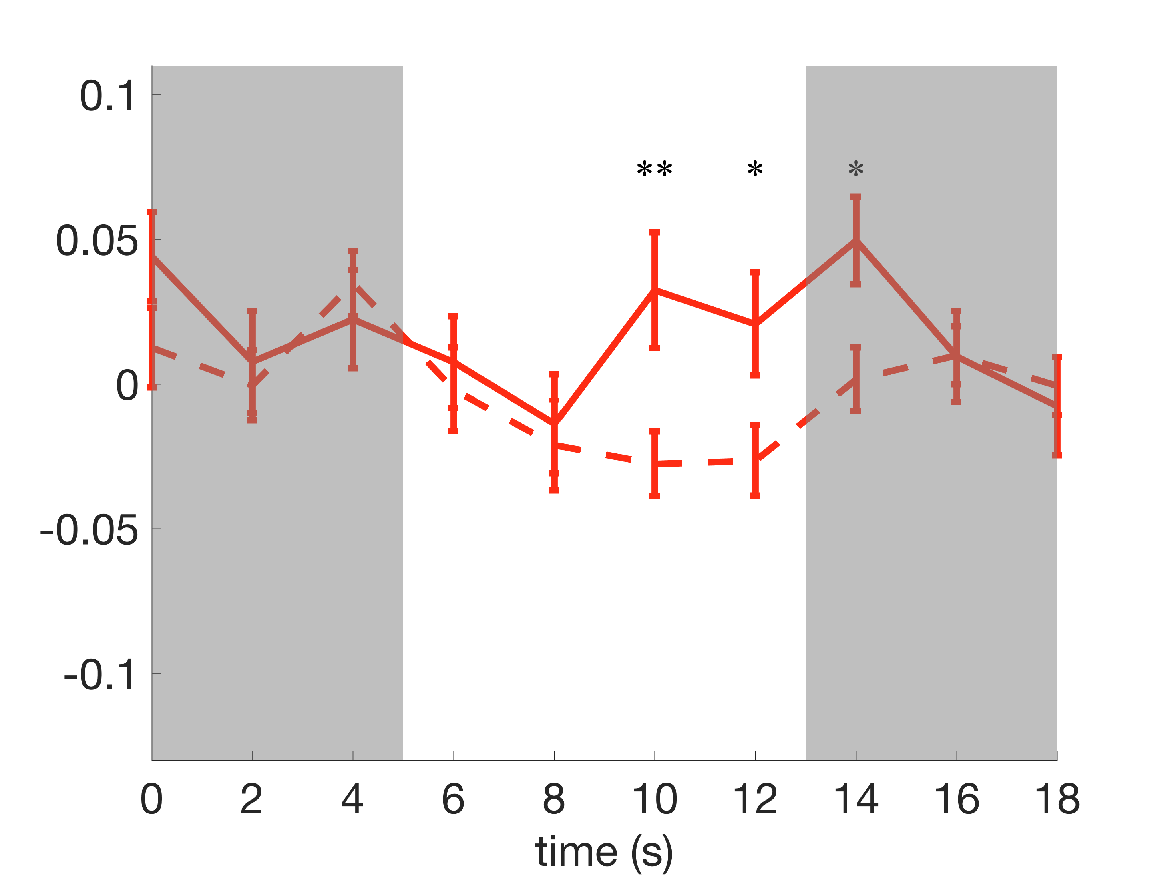
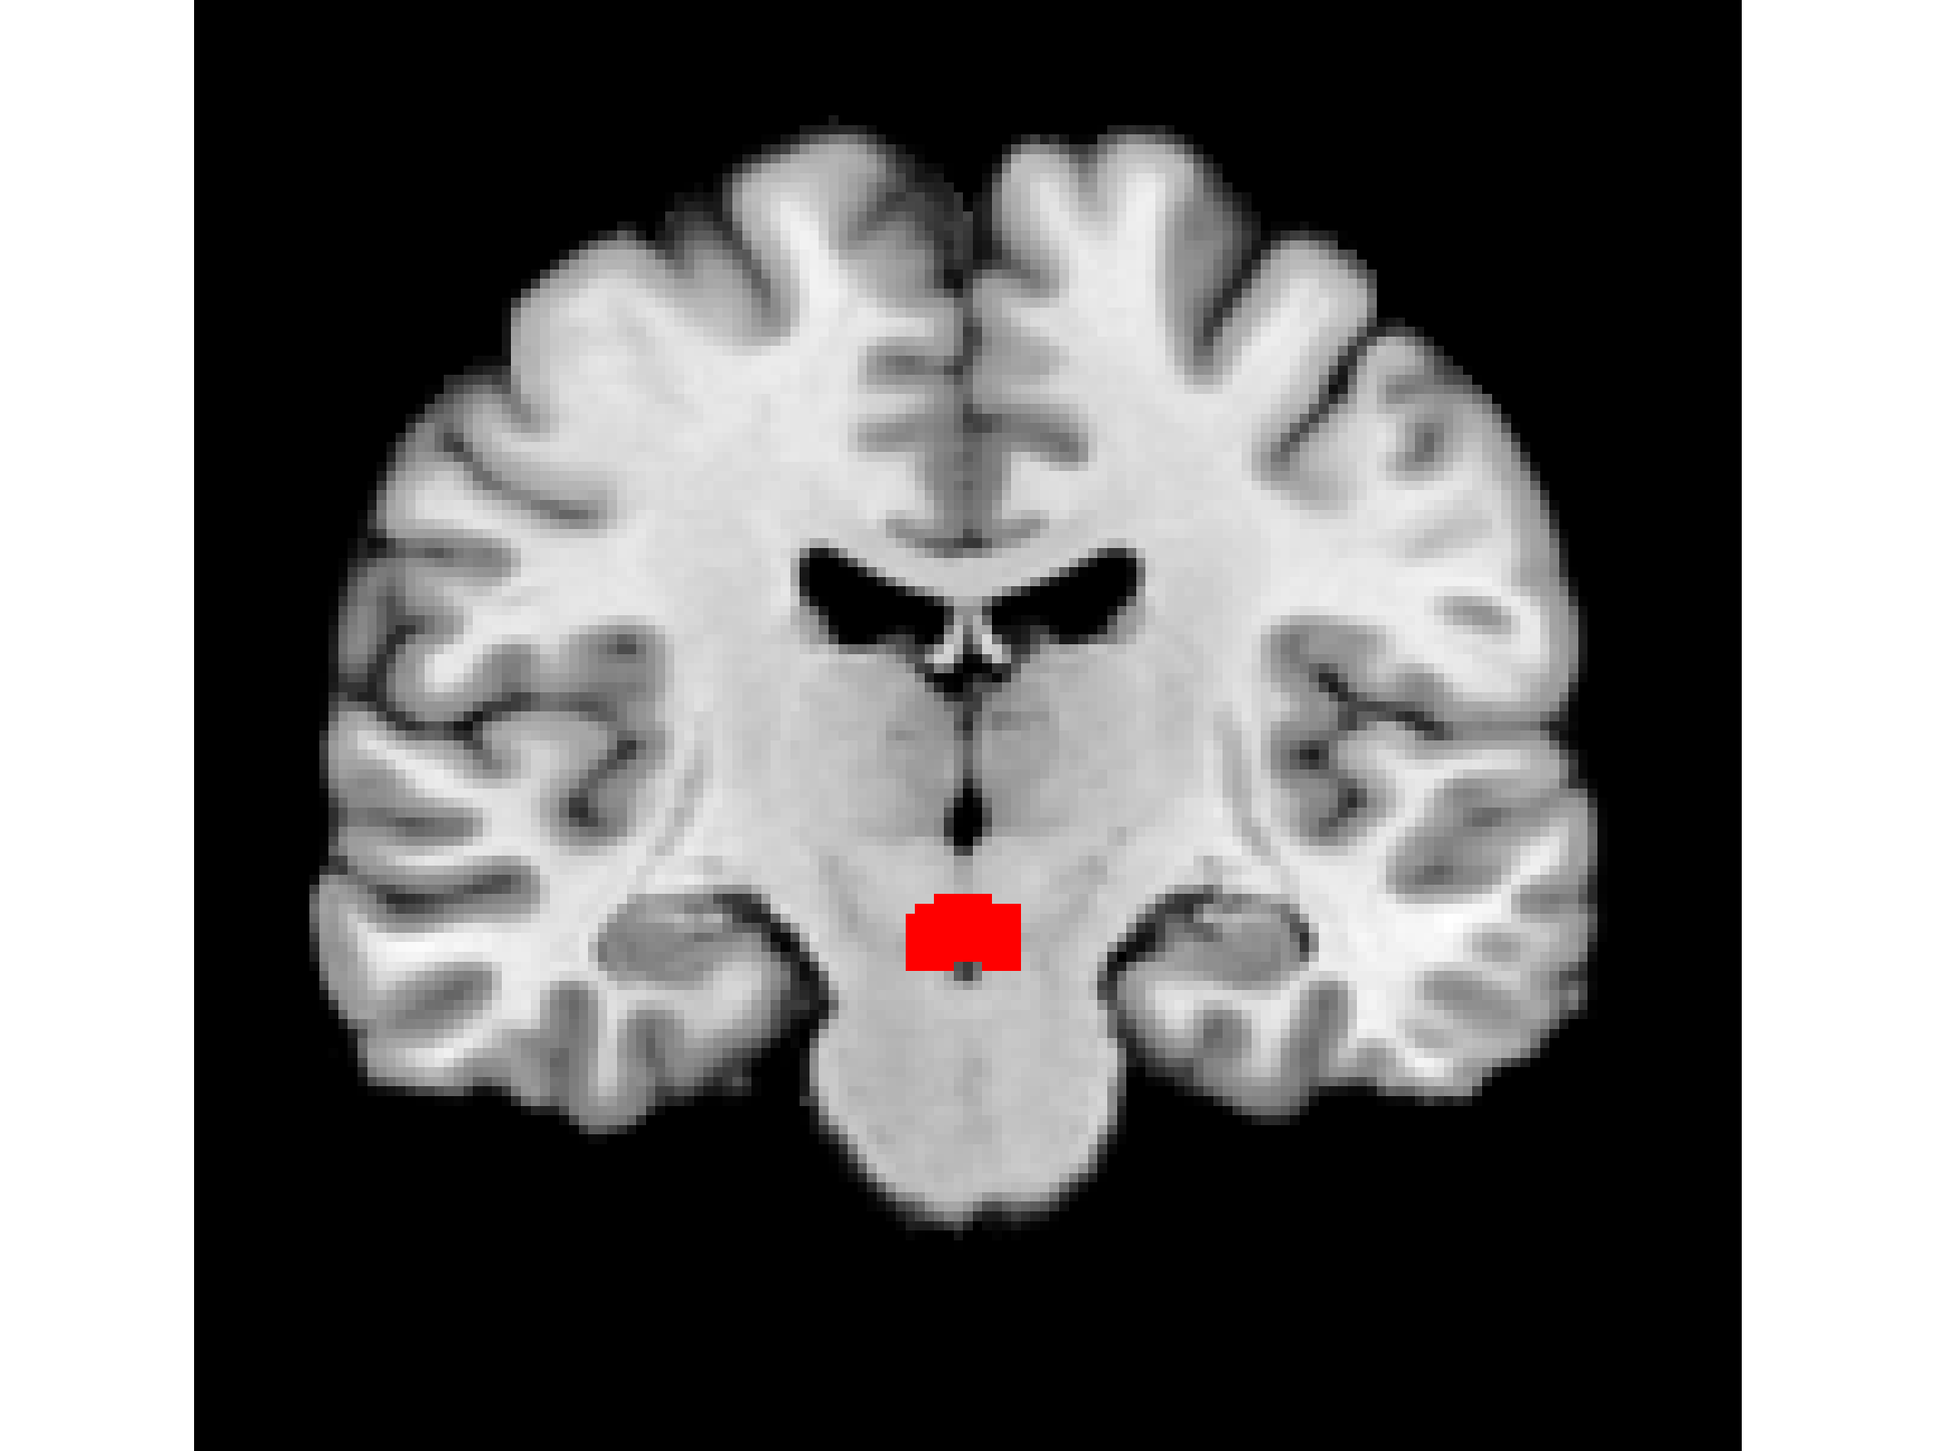
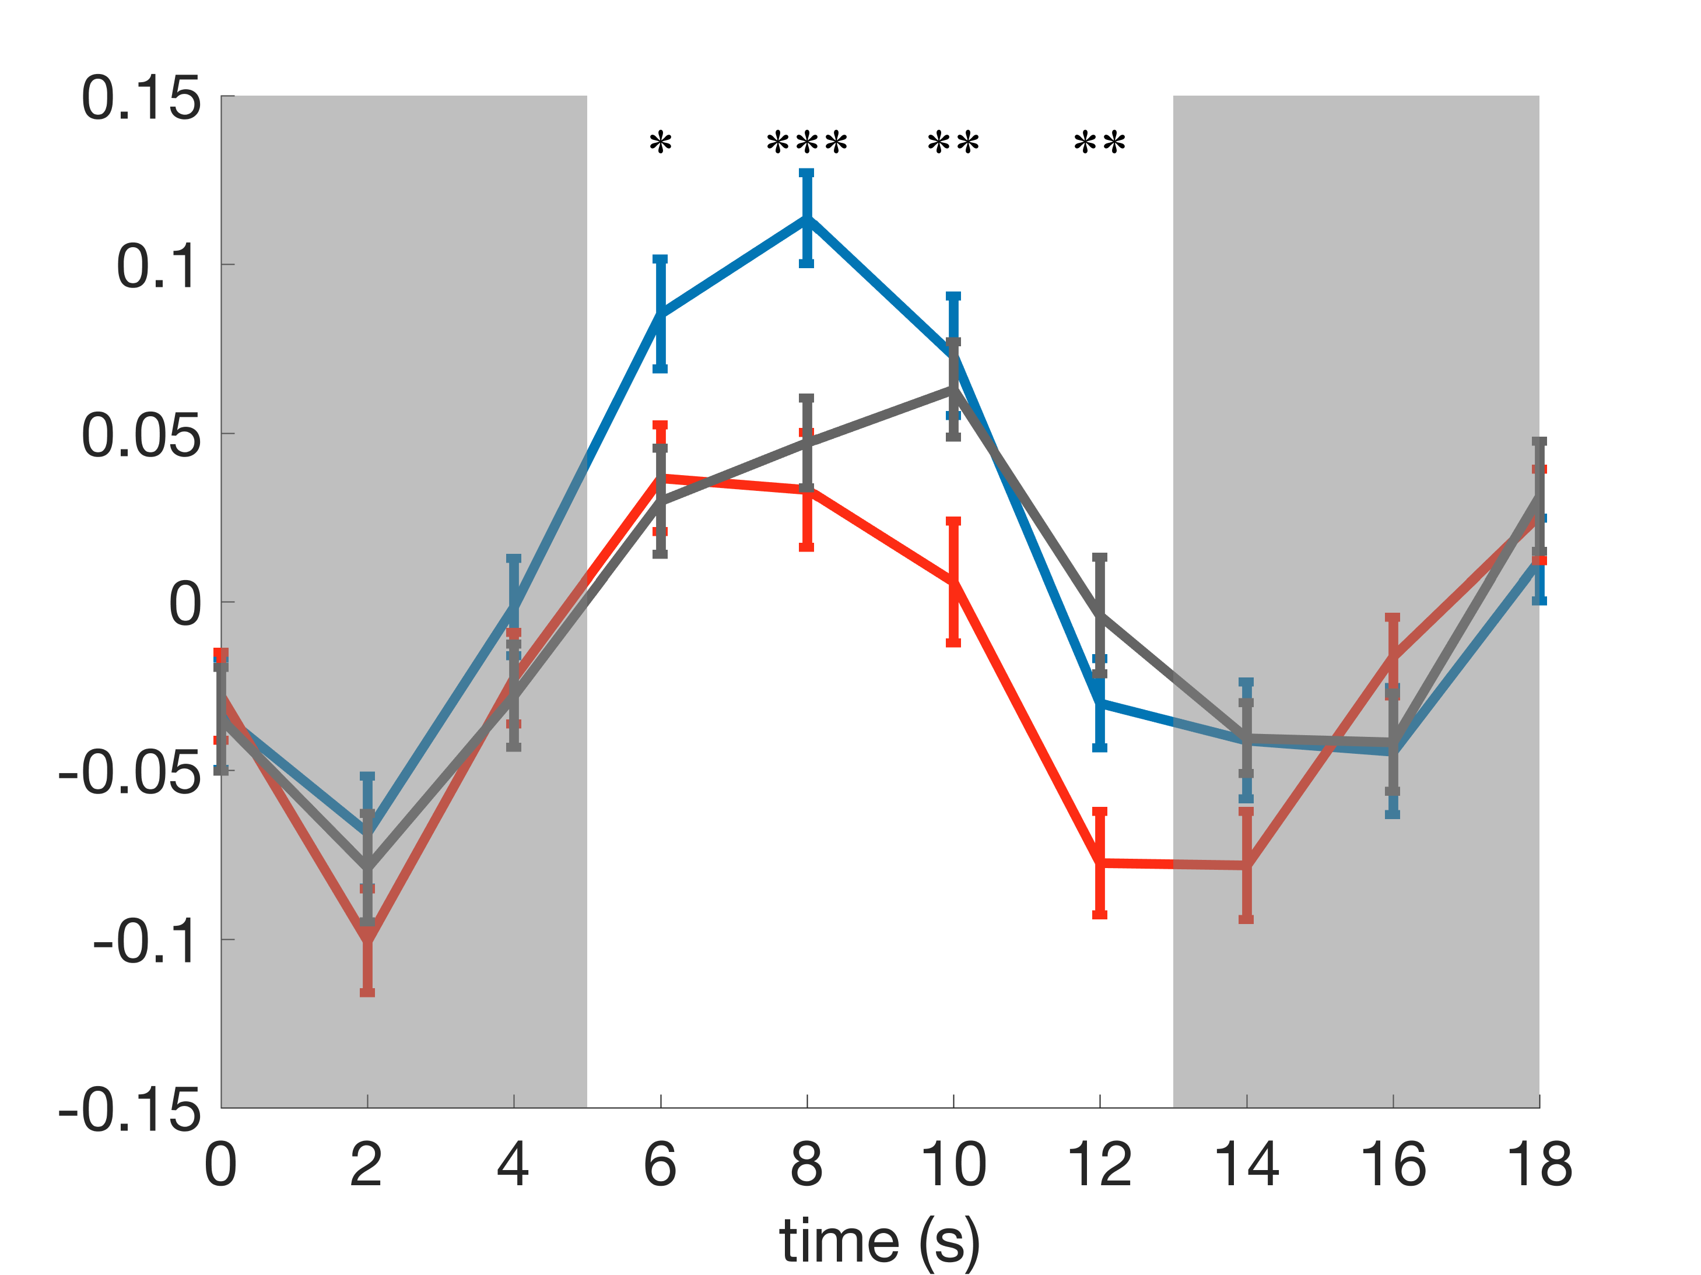
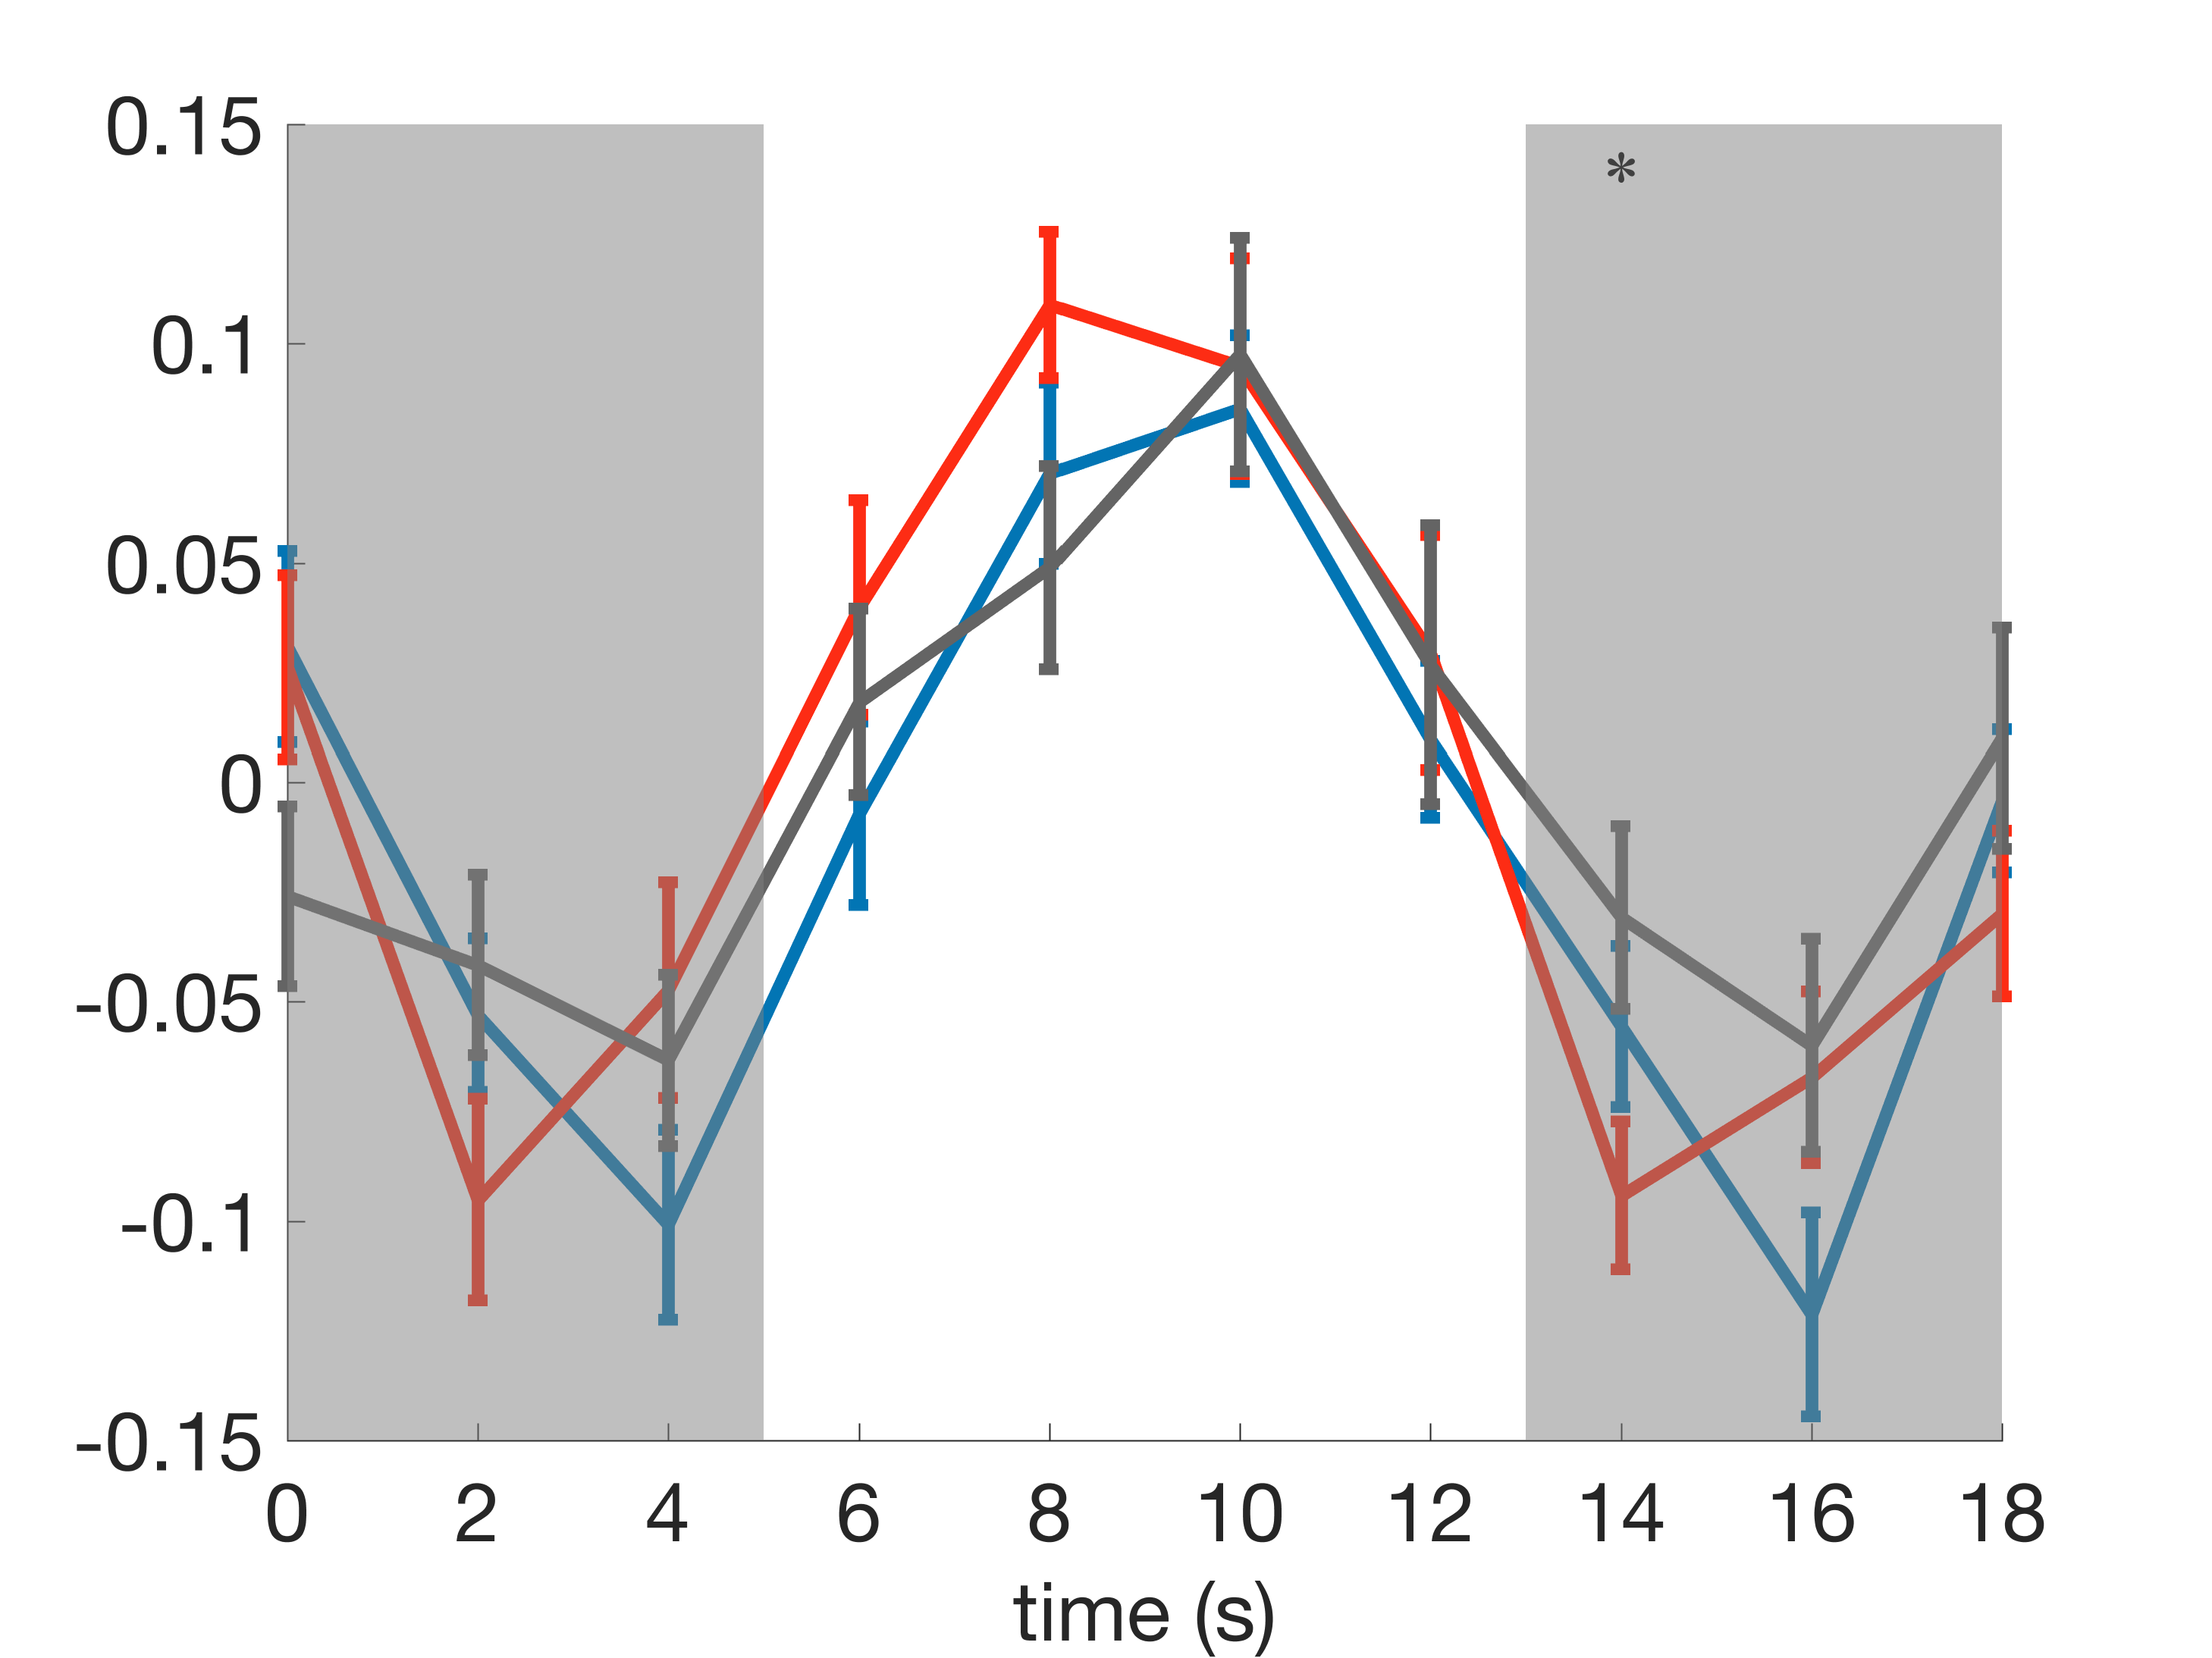
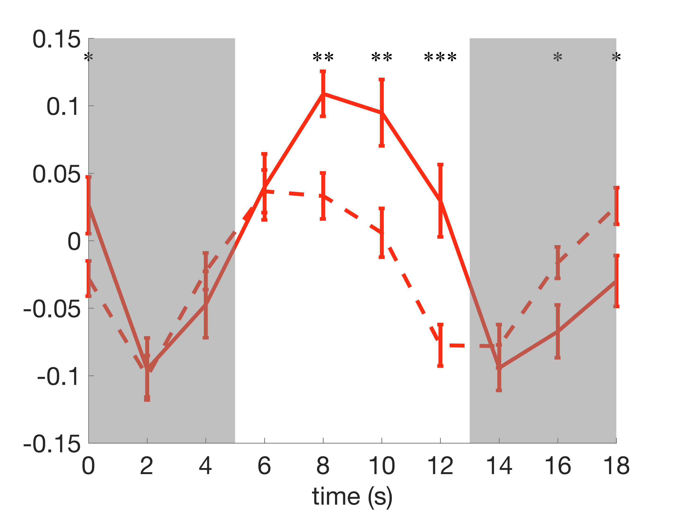
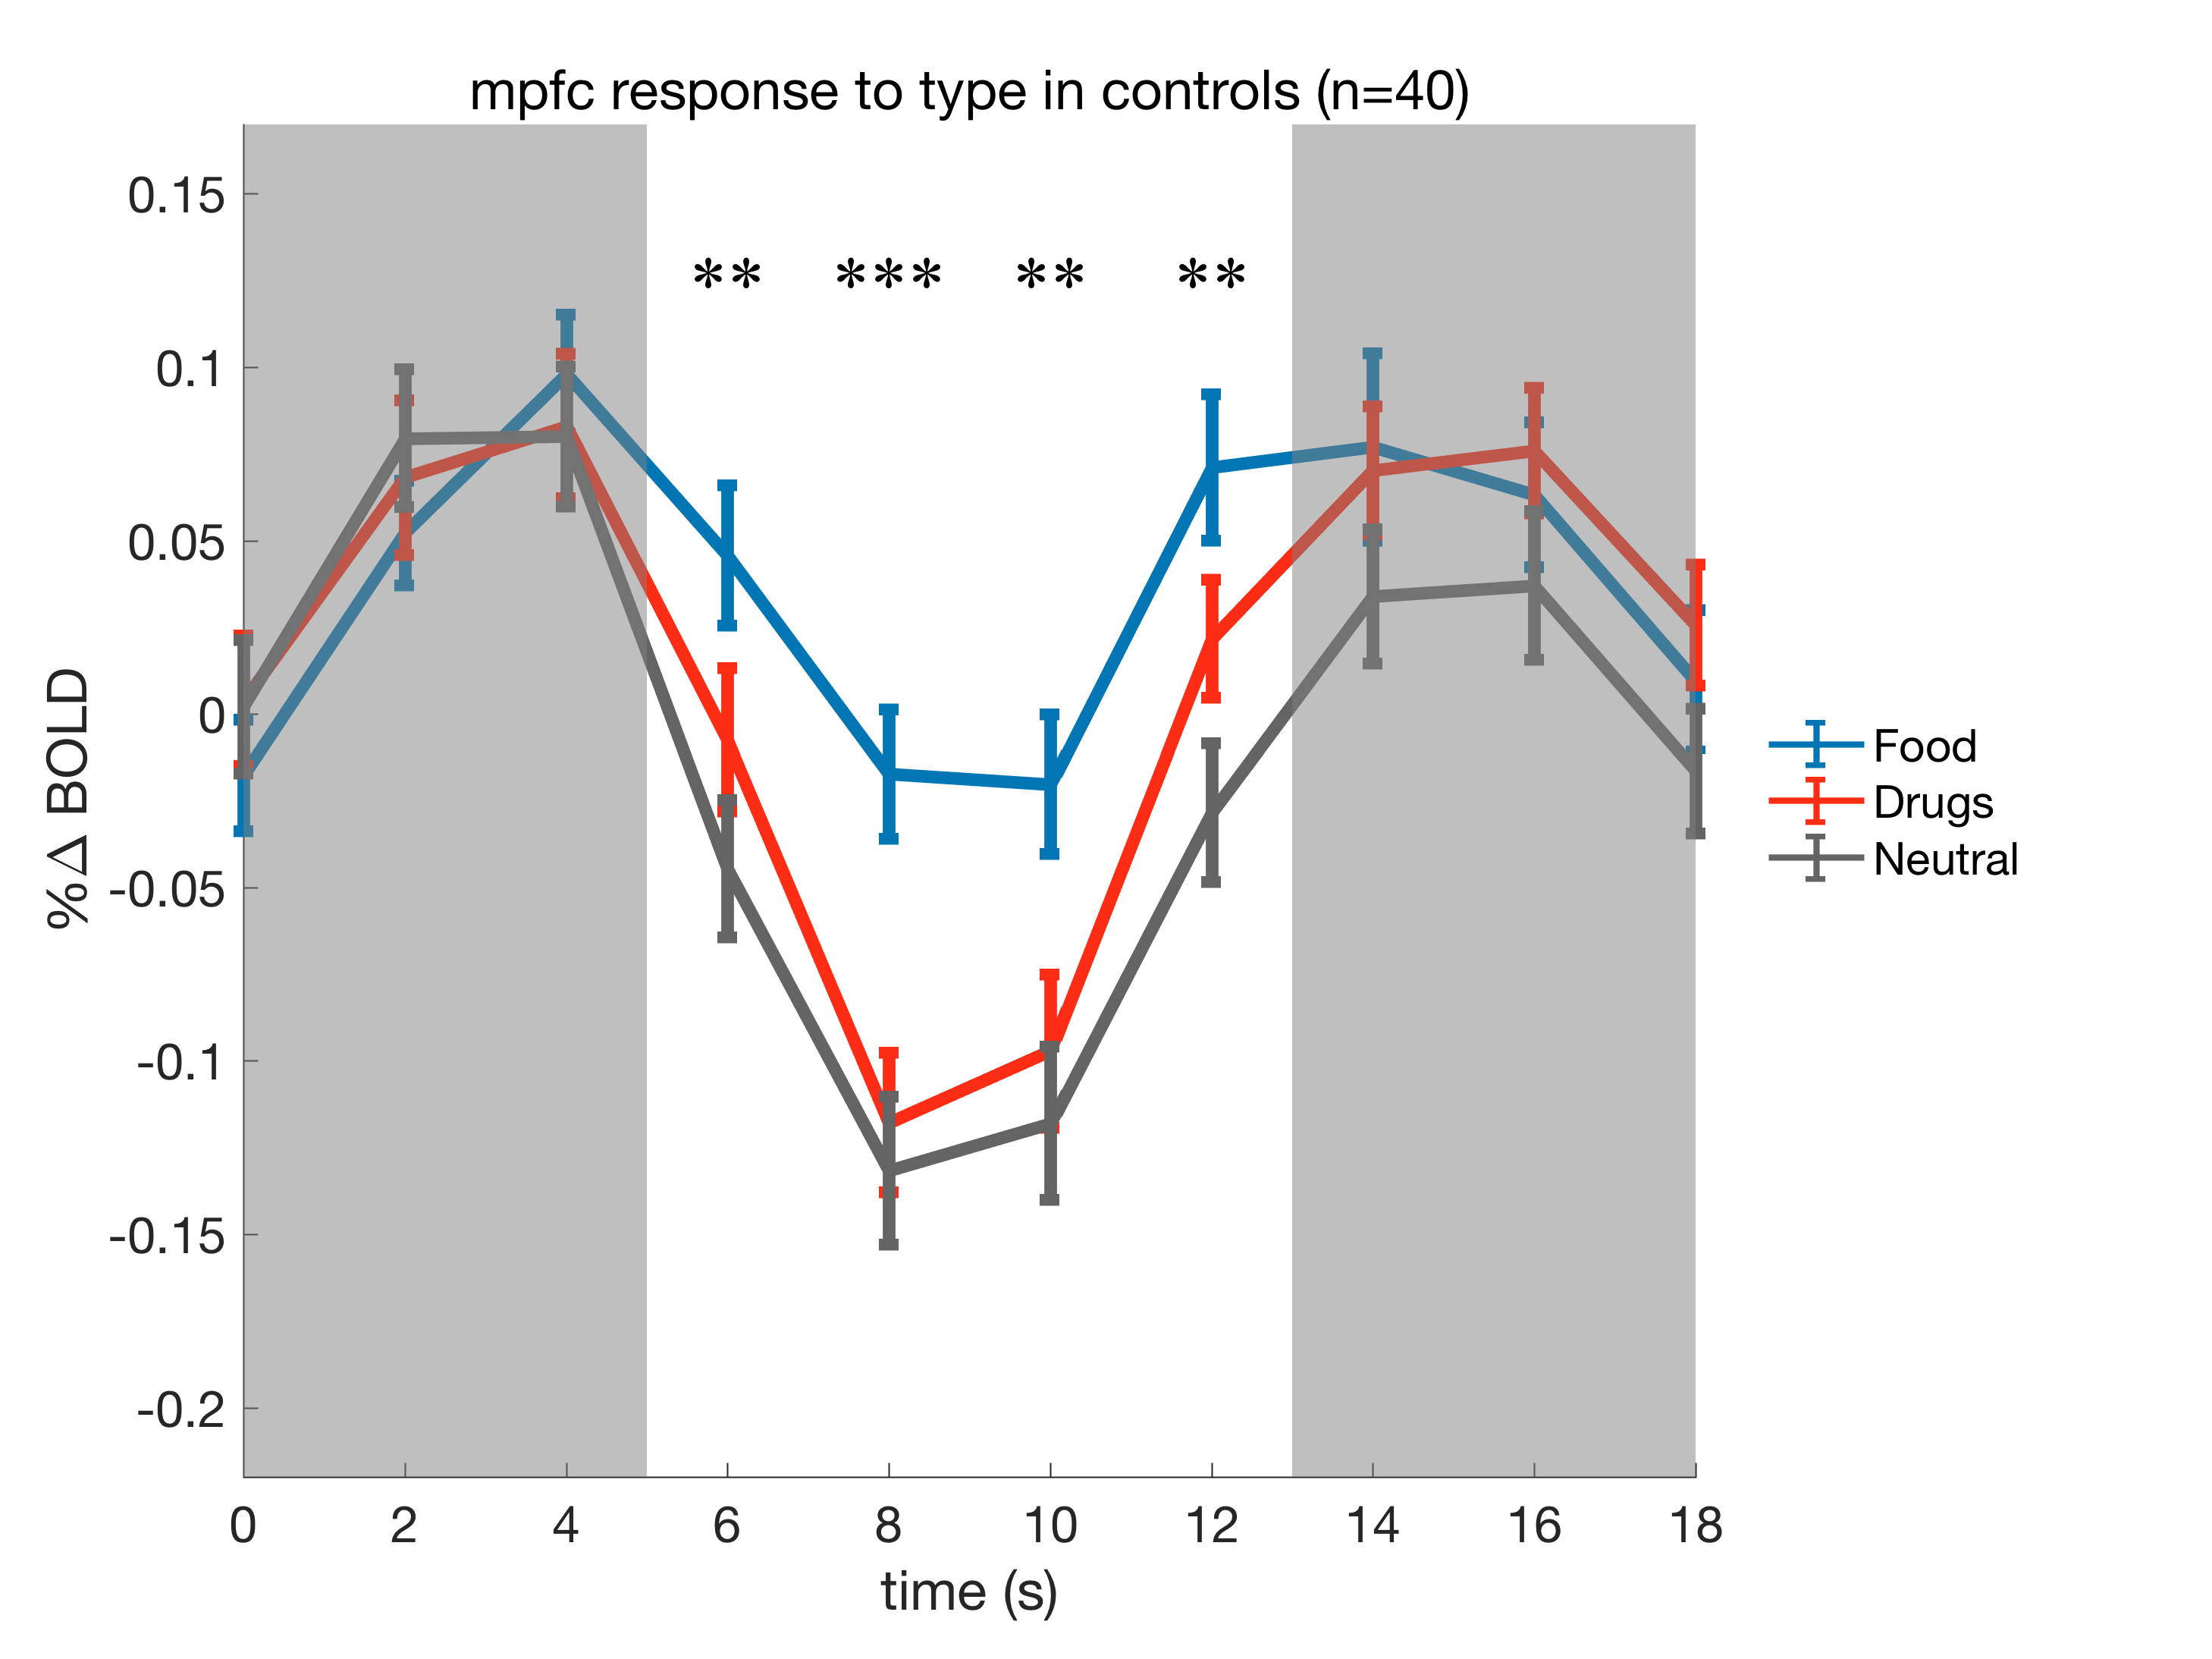
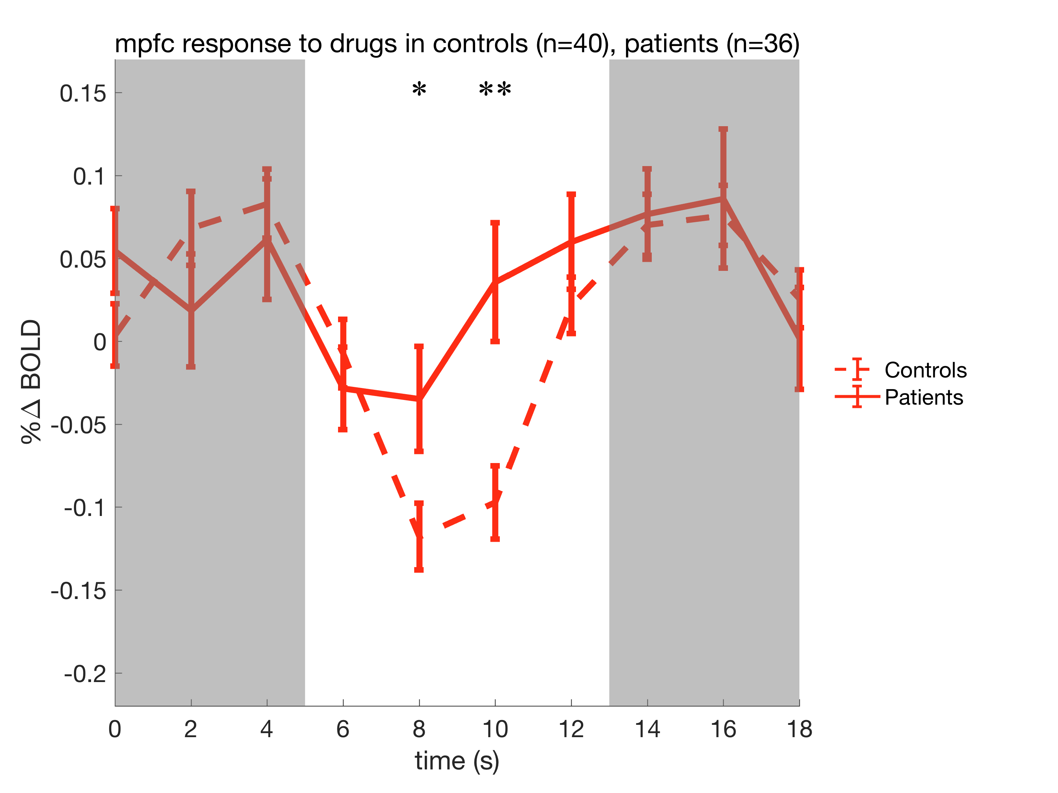
Nucleus Accumbens Response to Stimulant Cues Predicts Relapse
Kelly MacNiven¹, Sarah I. Hudson¹, Emily L. S. Jensen¹, Nicholas Borg¹, Claudia B. Padula³, Keith Humphreys^{2,3}, Brian Knutson¹
Departments of Psychology¹ and Psychiatry & Behavioral Sciences¹, Stanford University
Veterans Affairs Palo Alto Health Care System³
Motivation
Results
Results
Addiction is a disease characterized by chronic relapse¹. Animal models of relapse suggest that drug-seeking is mediated by mesolimbic dopamine release, which “hijacks” motivational mechanisms towards the pursuit of drug rewards^{2,3}. Despite the prevalence of this view, there is little evidence connecting mesolimbic activity to relapse in humans. We aimed to address this by directly testing whether drug cues elicit mesolimbic responses, and whether these responses predict relapse in human stimulant users.
Self-reported desire for drugs does not predict relapse
Nucleus Accumbens response to drug cues predicts relapse @ 3 months post-treatment
 | Demo/Clinical | Self-report | Neural | Combined
Model Intercept | -0.63 (0.39) -1.61 | -0.54 (0.38) -1.43 | -0.75 (0.45) -1.67 | -0.73 (0.45) -1.62
Age | 0.39 (0.41)* 1.97 |  |  | 0.87 (0.50) 1.74 †
Drug preference |  | -0.49 (0.47) -1.06
Craving |  | 0.41 (0.41) 1.00
Negative mood |  | 0.45 (0.44) 1.03
mPFC |  |  | -0.64 (0.46) 1.37
NAcc |  |  | 1.45 (0.57)* 2.55 | 1.34 (0.56)* 2.38
VTA |  |  | 0.44 (0.46) 0.97
Pseudo R² | 0.13* | 0.06 | 0.30** | 0.33**
Akaike Inf. Crit. (AIC) | 42.95 | 48.23 | 39.82 | 36.95
Classification Accuracy | 66.4% | 45.6% | 65.5% | 69.1%
Main questions
*** p < 0.001
Do stimulant users show increased mesolimbic responses to drug cues relative to controls?
Can neural responses to drug cues predict future relapse in stimulant users, above and beyond predictions based on clinical, demographic, and behavioral factors?
Stimulant users show increased mesolimbic responses to drug cues relative to controls
Controls
Patients
Patients > Controls
A=6
R
Food >
Neutral
Z
Statistics are standardized regression coefficients with standard error in parentheses, and Z-scores.
† p < 0.10; * p < 0.05; ** p < 0.01
Methods
+4.42
Nucleus Accumbens predicts time to relapse as a continuous measure
+3.89
Subjects: Stimulant-dependent veteran patients (n=36) were recruited from a 28-day in-patient rehabilitation program during weeks 2-4, and control subjects (n=40) were recruited from the community.
Drugs > Neutral
+3.29
+/-2.58
-3.29
-3.89
Paradigm & Procedure
Subjects were scanned while completing a cue reactivity task involving pictures of food and drugs (reward stimuli) and everyday objects (control stimuli). In patients only, follow-up assessments of recovery occurred up to one year after scanning.
Drugs >
Food
-4.42
Kaplan-Meier survival curves for all patients (left), and median split according to NAcc responses to drug cues (middle). Cox regression confirmed that drug cue-elicited NAcc activity was associated with an elevated risk for relapse (hazard ratio=2.30; 95% CI, 1.40-3.79).
Volume
Controls
Patients
Patient vs. Control Drug Response
Conclusions
MPFC
% ∆ BOLD
Relative to controls, patients exhibited increased activity in mesolimbic circuits to drug reward cues.
Patients’ NAcc drug responses predict future relapse (and time to relapse) above and beyond demographic, clinical, and behavioral measures.
Mesolimbic circuitry may be successfully targeted for interventions to prevent relapse
NAcc
% ∆ BOLD
VTA
References & Acknowledgements
% ∆ BOLD
Miller, W.R. et al. (1996). Addiction, 91: 155-172.
Di Chiara, G. & Imperato, A. (1988). PNAS, 85(14), 5274-5278.
3. Volkow, N.D. et al. (2002). Neurobiology of learning and memory, 78(3), 610-624.
This work is supported by NeuroChoice, an Initiative of the Stanford Neurosciences Institute.

